Slide 1
Building a Color-Sorter:
Ctrl+Alt+Elite

Slide 2
Color-Sorter Robot
This unit is a walk-through the process of building a robot that sorts out marbles by their colors
It is required to finish previous units before starting this one

Slide 3
List of Materials
Components:
Arduino
Mini Breadboard
Cut out design from MDF
Zip ties
Color Sensor
2x Servo
M/F and M/M wires

Slide 4
List of Materials
Components
Arduino
Mini-Breadboard
H-bridge
2 Wheels + Gearboxes
M/F Jumper Wires
M/M Jumper Wires
9V Battery
9V Battery cable
Ball bearing
Foam square (10cm x 12cm)
Tools
Scissors
Double sided tape

Slide 5
Section 1:
Servos

Slide 6
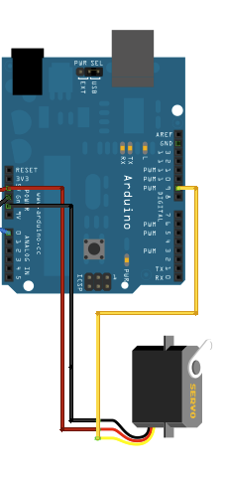
Servos
Recall from Unit #6
How to test the servo?
Move the servo to 30, 90 and 145 degrees
Repeat for both servos
Notes:
Solution is in the Unit folder (ServoTest.ino)

Slide 7
Section 2:
Color Sensor

Slide 8
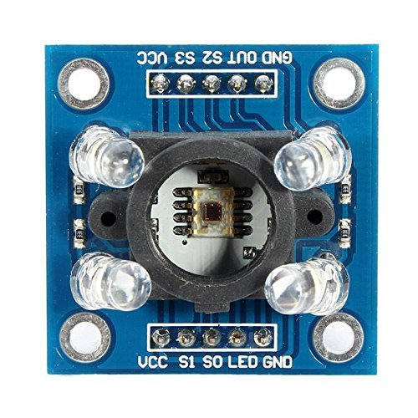
Color Sensor TCS3200
Recall from unit #6 how color sensor works
We will be using the attached library “TCS3200.h”
Test the color sensor for different colors using colored papers.
*DO NOT use data based on these readings. Readings will be different with the color sensor mounted inside the sorter and with sensing the marbles
Notes:
Solution is in the Unit folder (ColorSensorTest.ino)

Slide 9
Section 3:
Assembly

Slide 10
Assembly
Assemble the pre-cut out design of the color-sorter
Make sure all the shelves are in correct position
Use zip ties to to mount the sliding parts to the servos
Make sure the marble picking part can be move across the whole range needed to pick up the marble and drop it afterwards
When you move the part mounted to the servo to the most right position allowed by the servo, it should slightly pass the dropping position
*DO NOT MOVE THE SERVO WHILE PLUGGED IN THE POWER

Slide 11
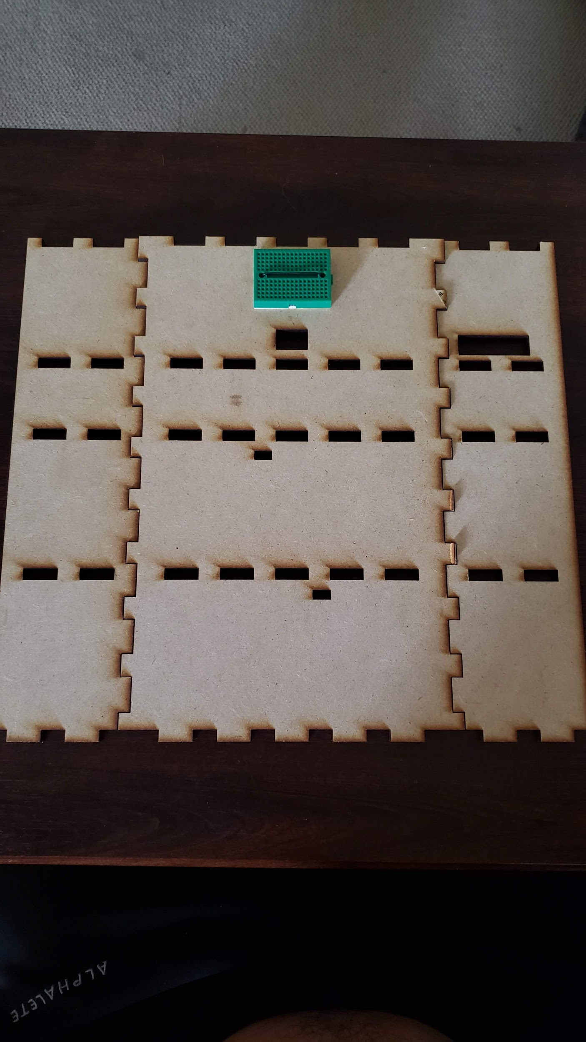
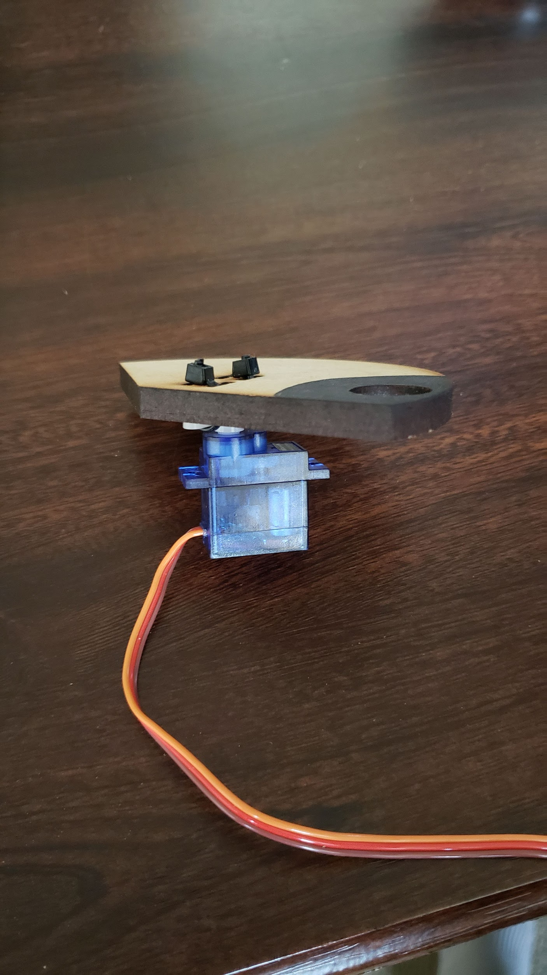
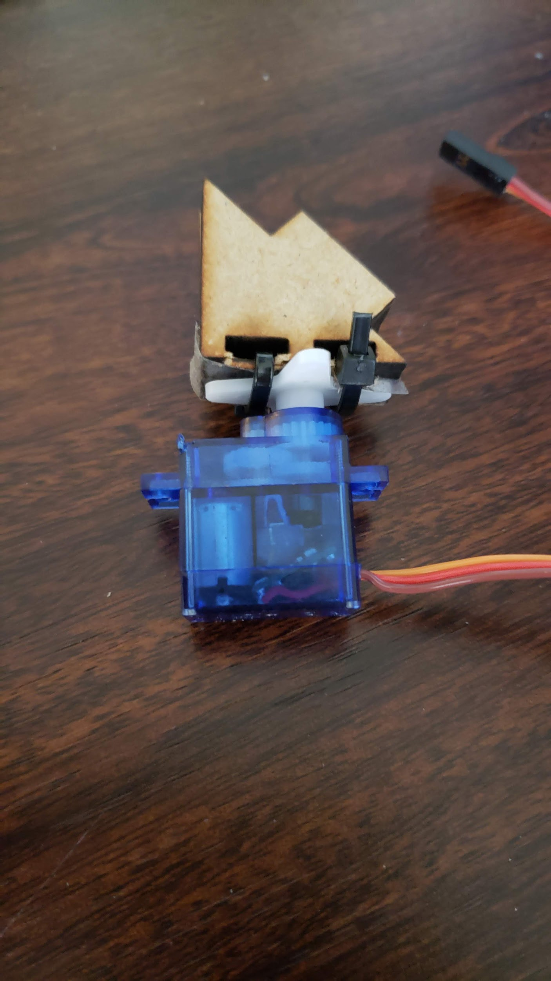
Assembly
2. Attach corresponding pieces to servos
1. Prepare your back wall with
mounted mini breadboard and
sides
Notes:
Make sure the servos can be

Slide 12
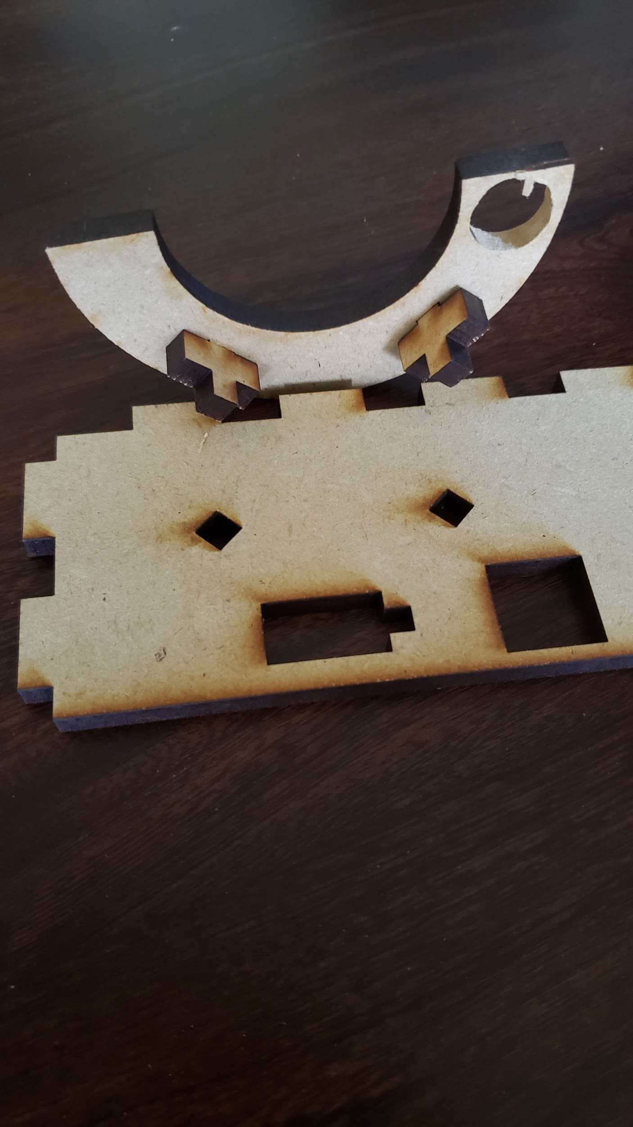
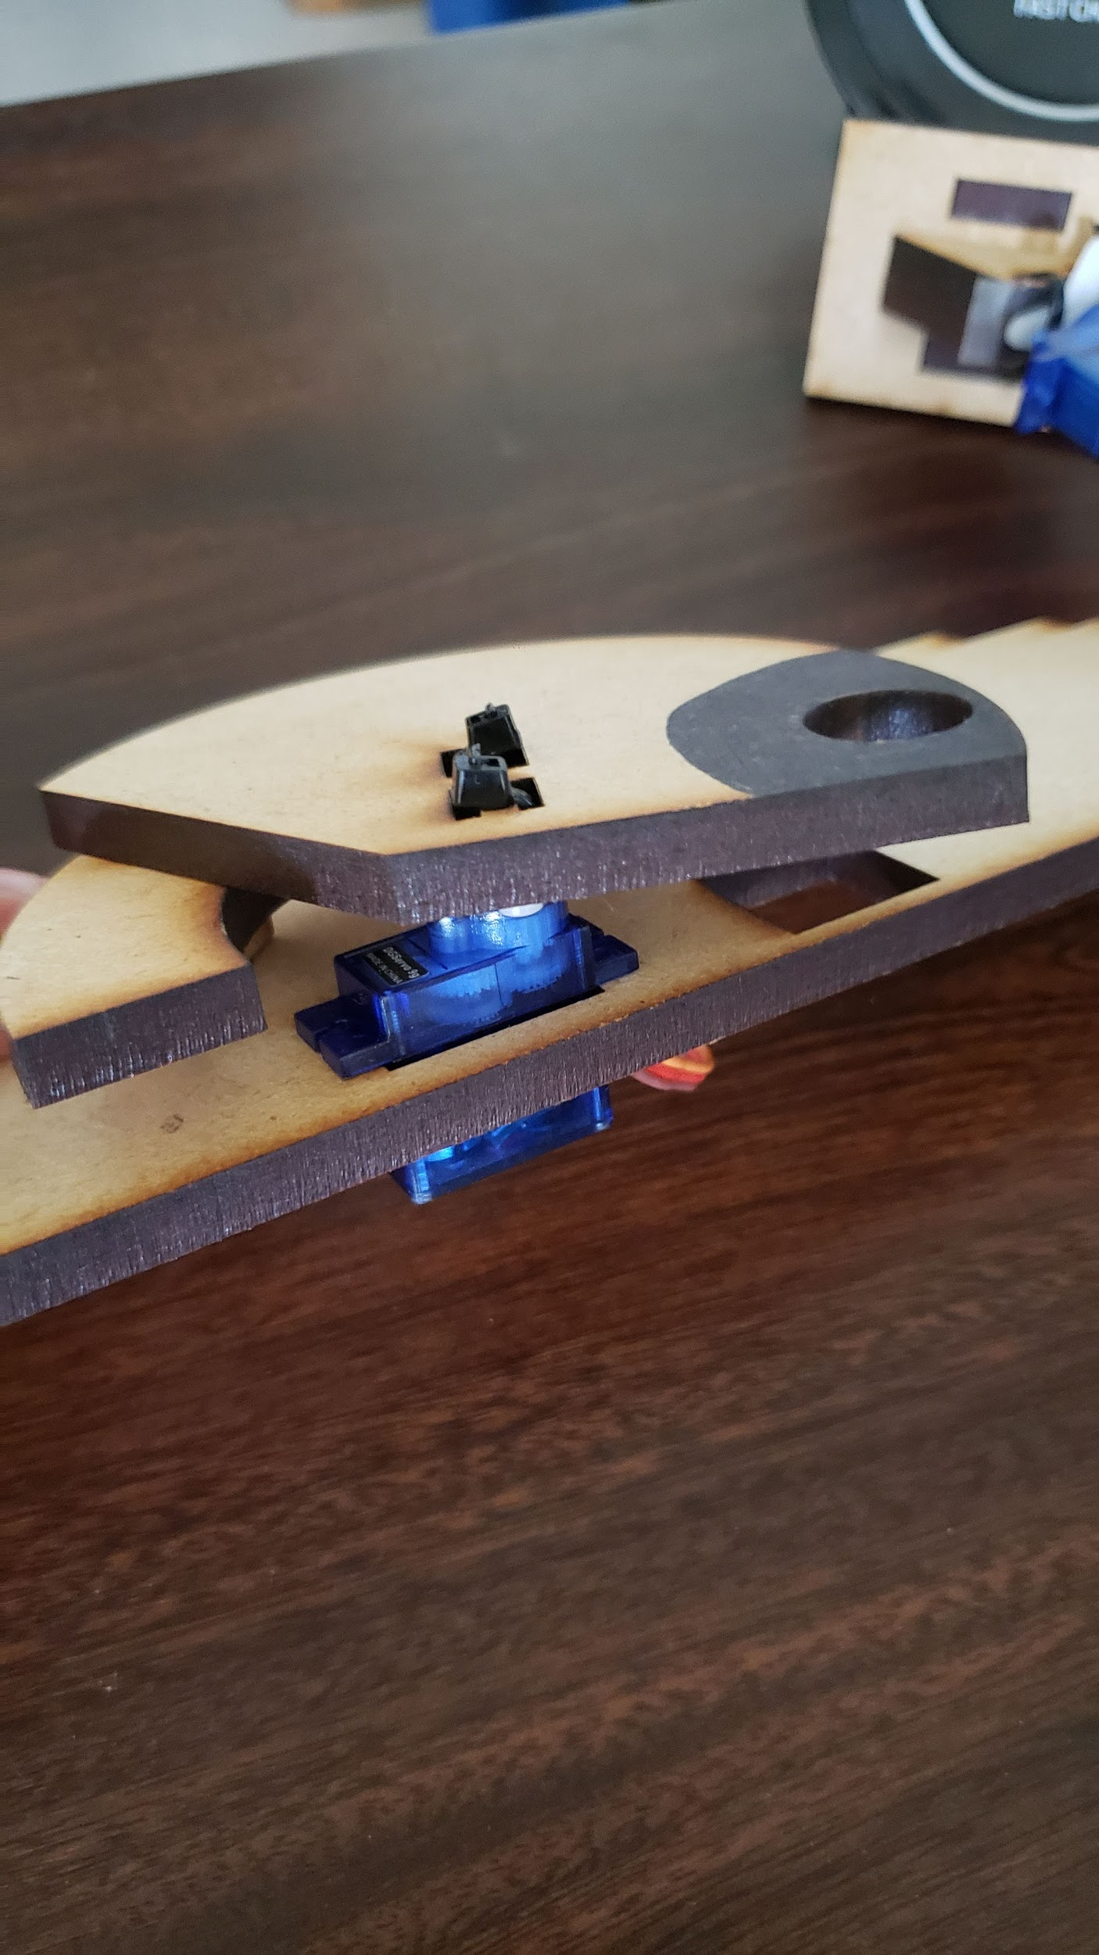
Assembly
3. Assemble the sliding part to the middle shelf and add servo to the designed whole *Add the chute servo to the bottom shelf

Slide 13
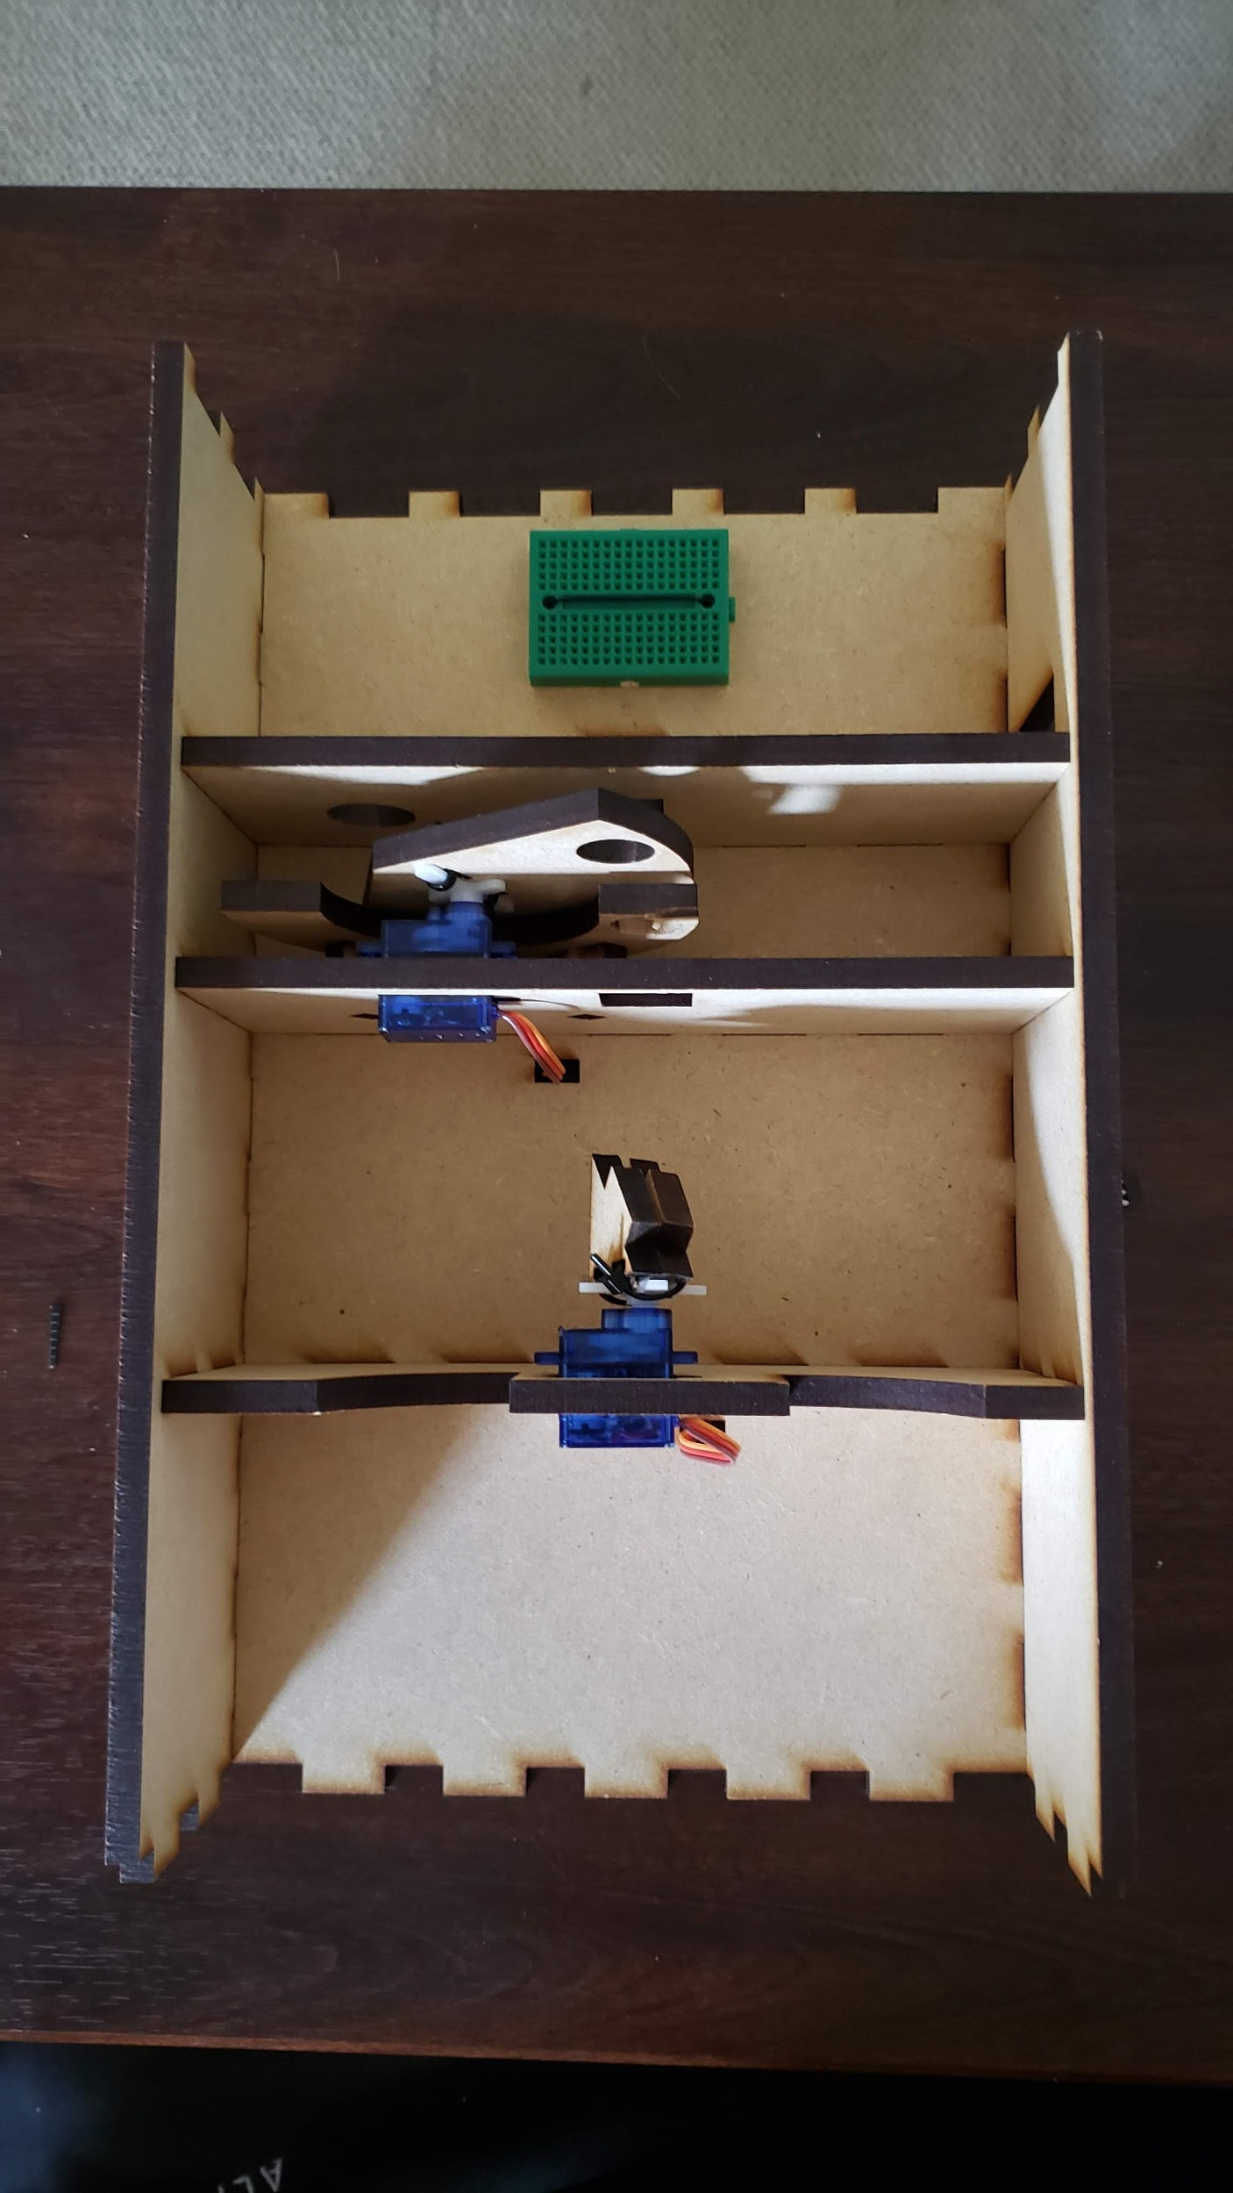
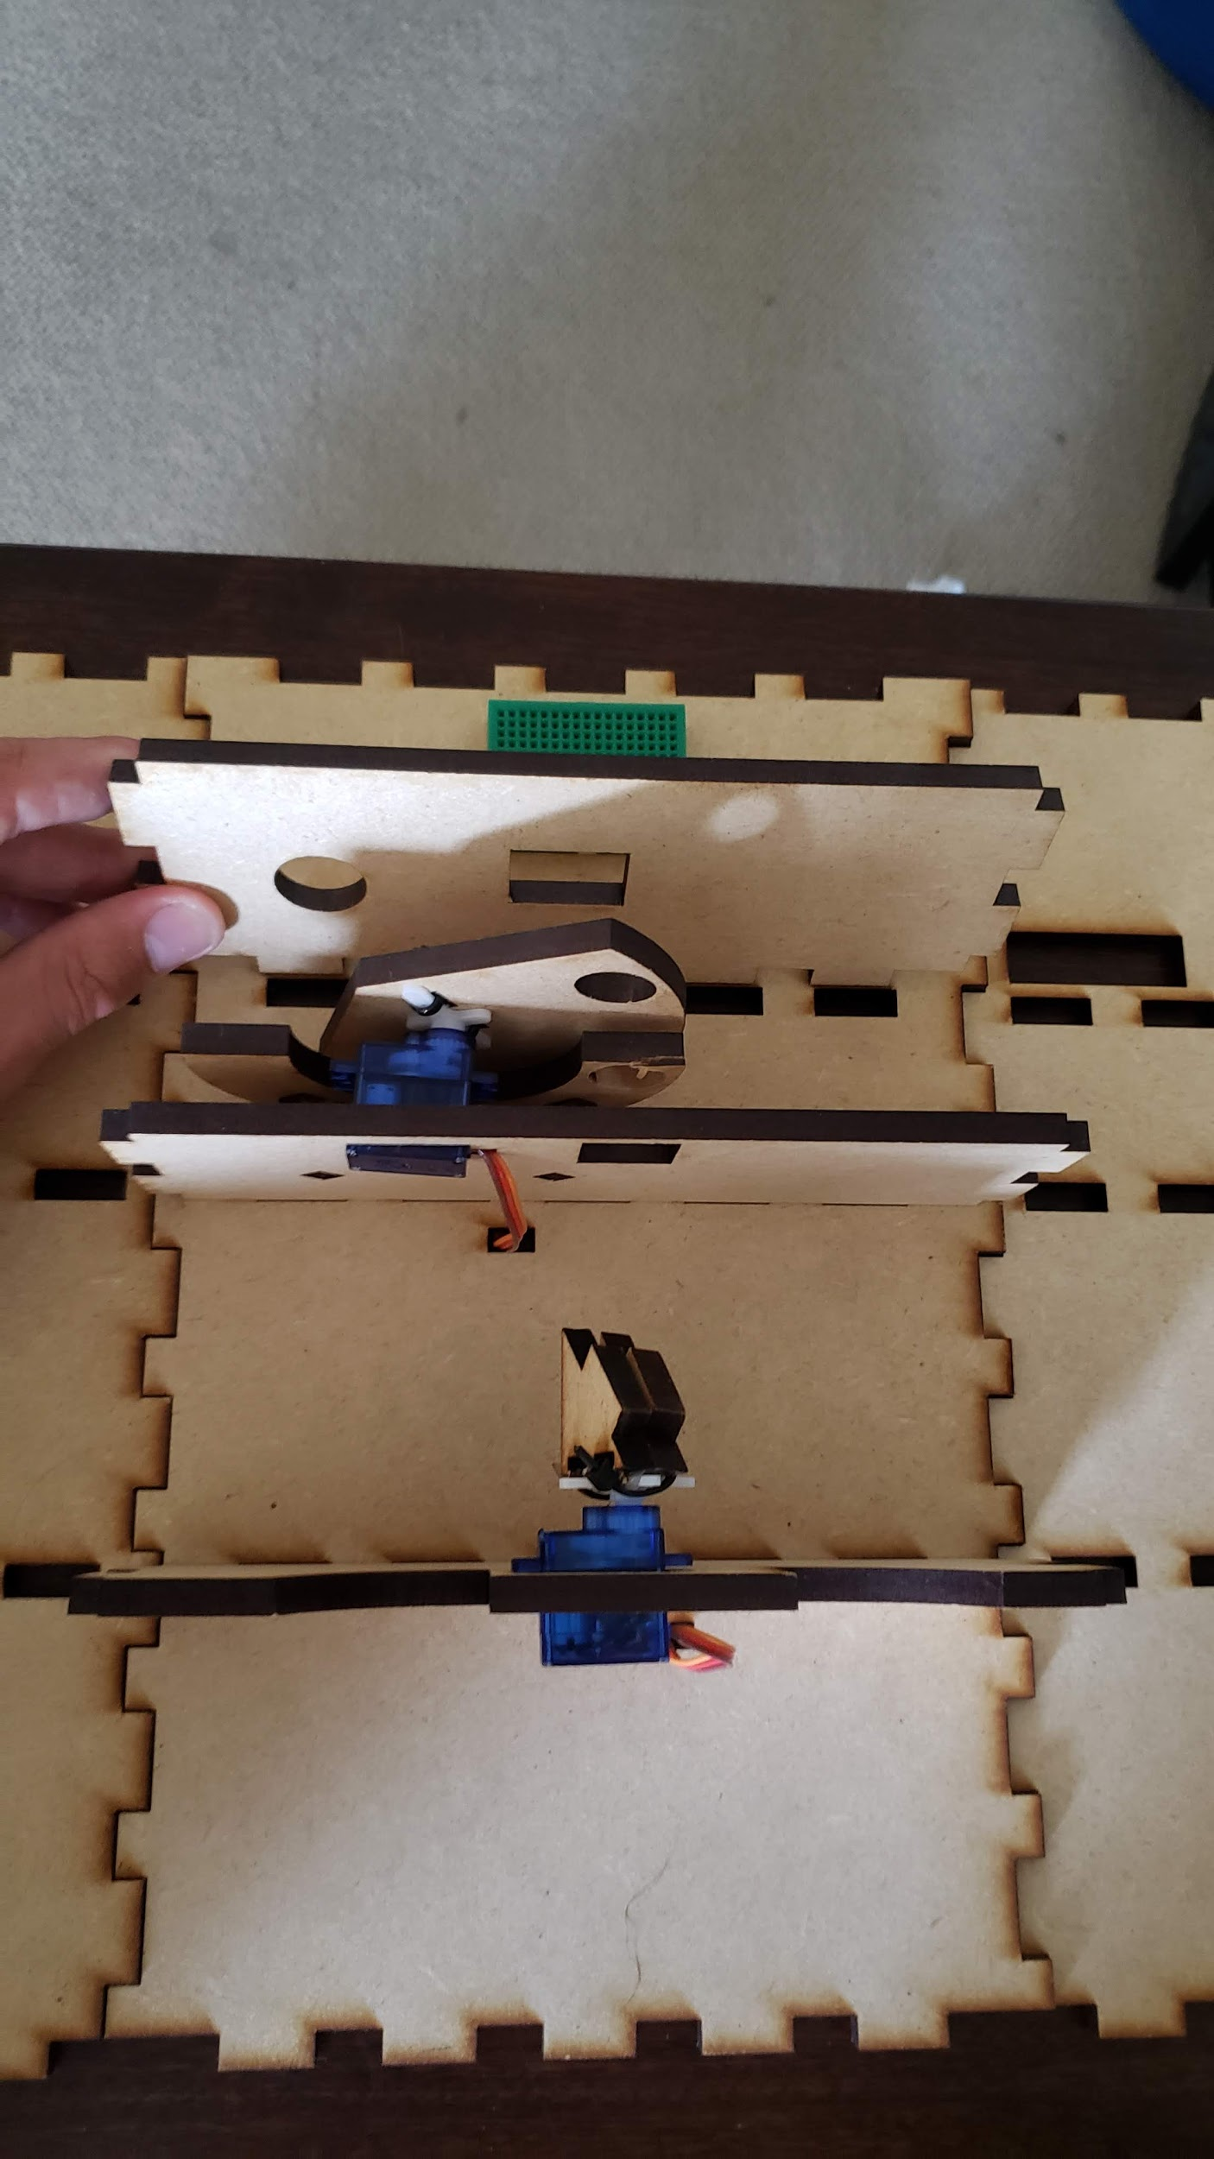
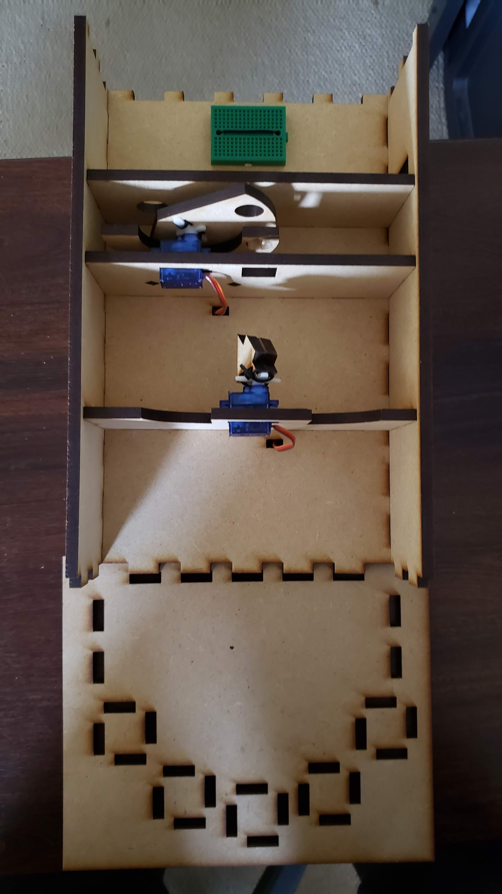
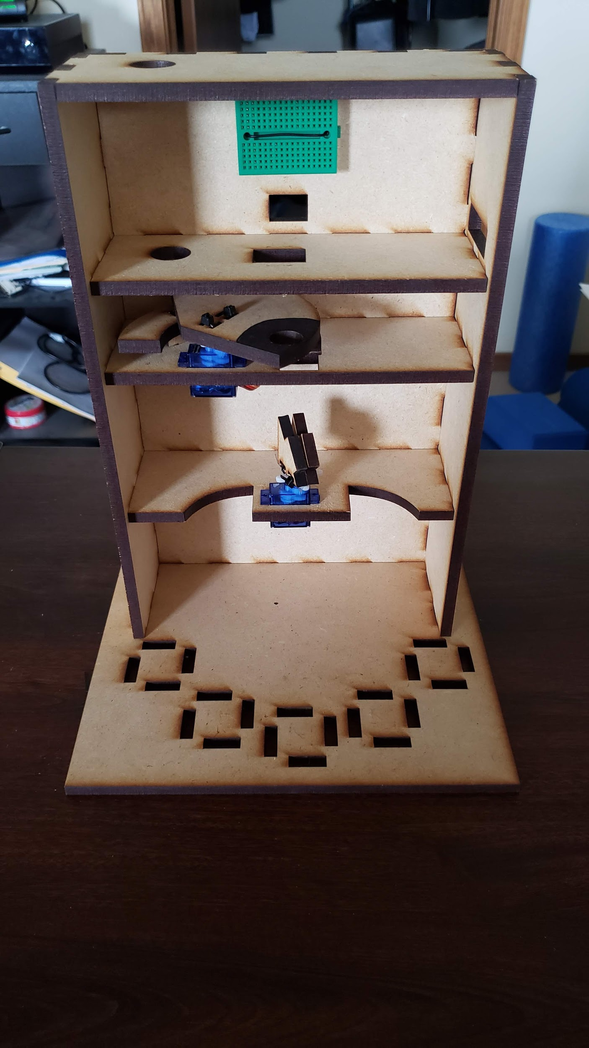
Assembly
5. Attach the construction into the bottom base and add top
4. Slide shelves into the back wall and
close the sides

Slide 14
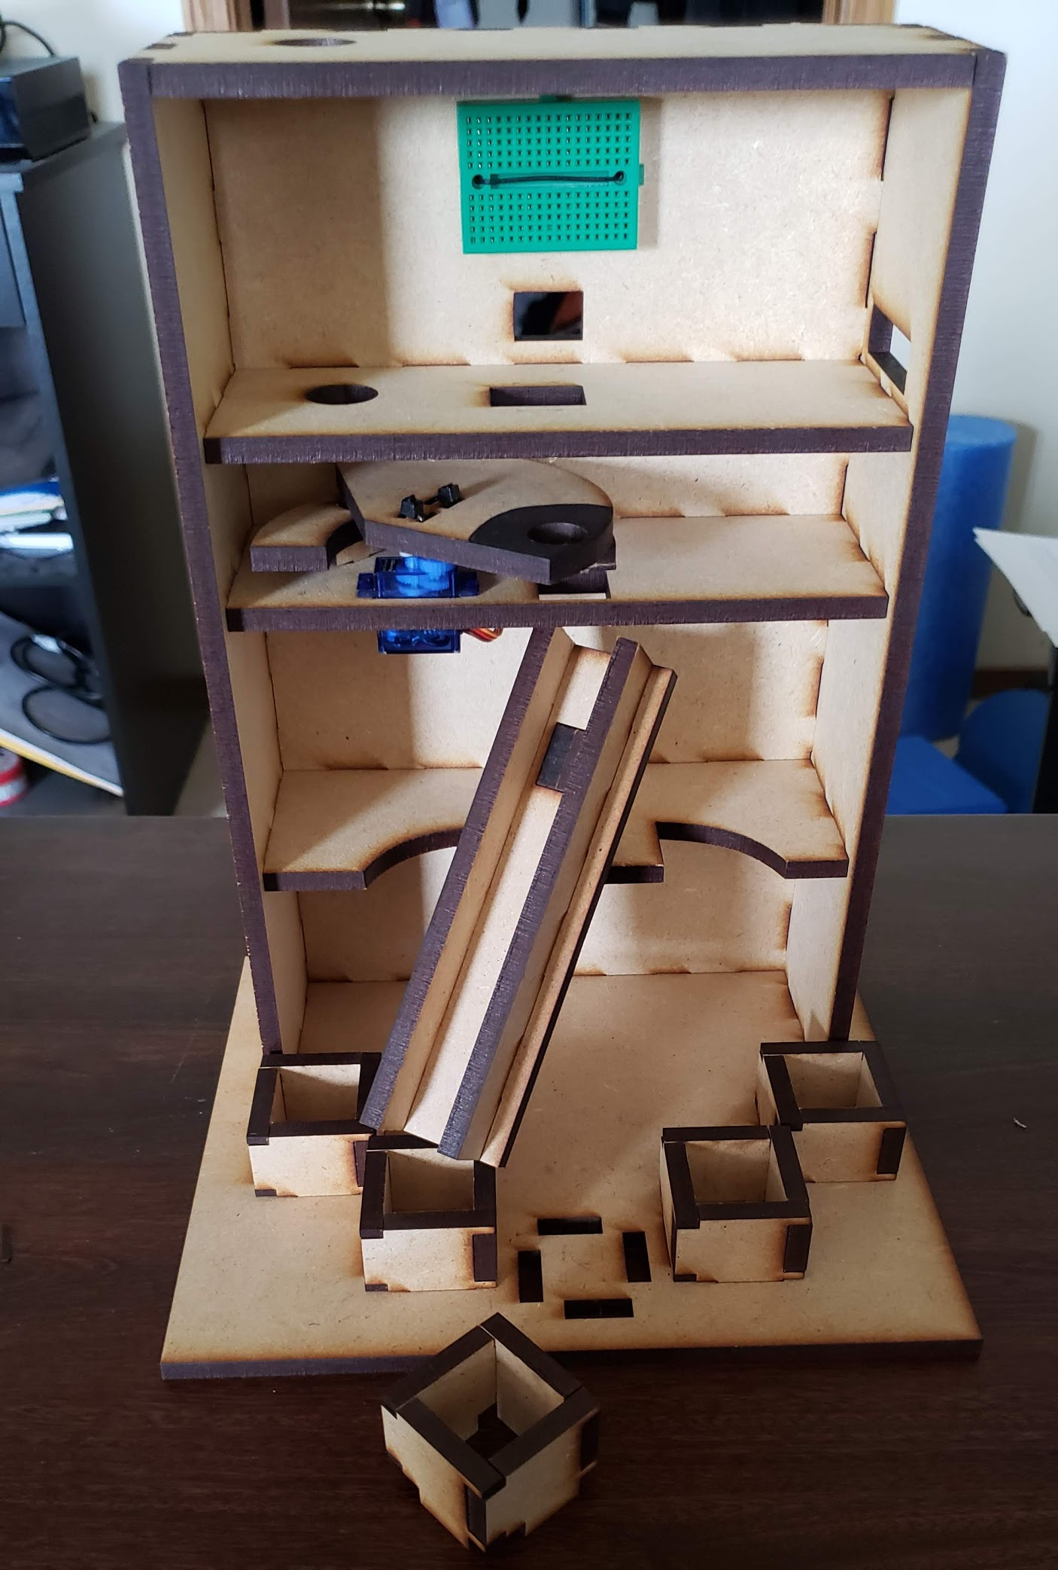
Assembly
6. Lastly add the catching cups and the chute
7. Put the color-sensor and arduino to
the top shelf, now we can start wiring

Slide 15
Section 4:
Wiring

Slide 16
Wiring
Upper Servo |  | Lower Servo |  | Color Sensor
Device Pin | Arduino Pin | Device Pin | Arduino Pin | Device Pin | Arduino Pin
GND | GND | GND | GND | OUT | 2
VCC | 5V | VCC | 5V | S0 | 3
Control | 8 | Control | 7 | S1 | 4
 |  |  |  | S2 | 5
 |  |  |  | S3 | 6
 |  |  |  | GND | GND
 |  |  |  | VCC | 5V
Connect the devices to the Arduino digital pins according to the table
Table 7.1 Pin Numbers

Slide 17
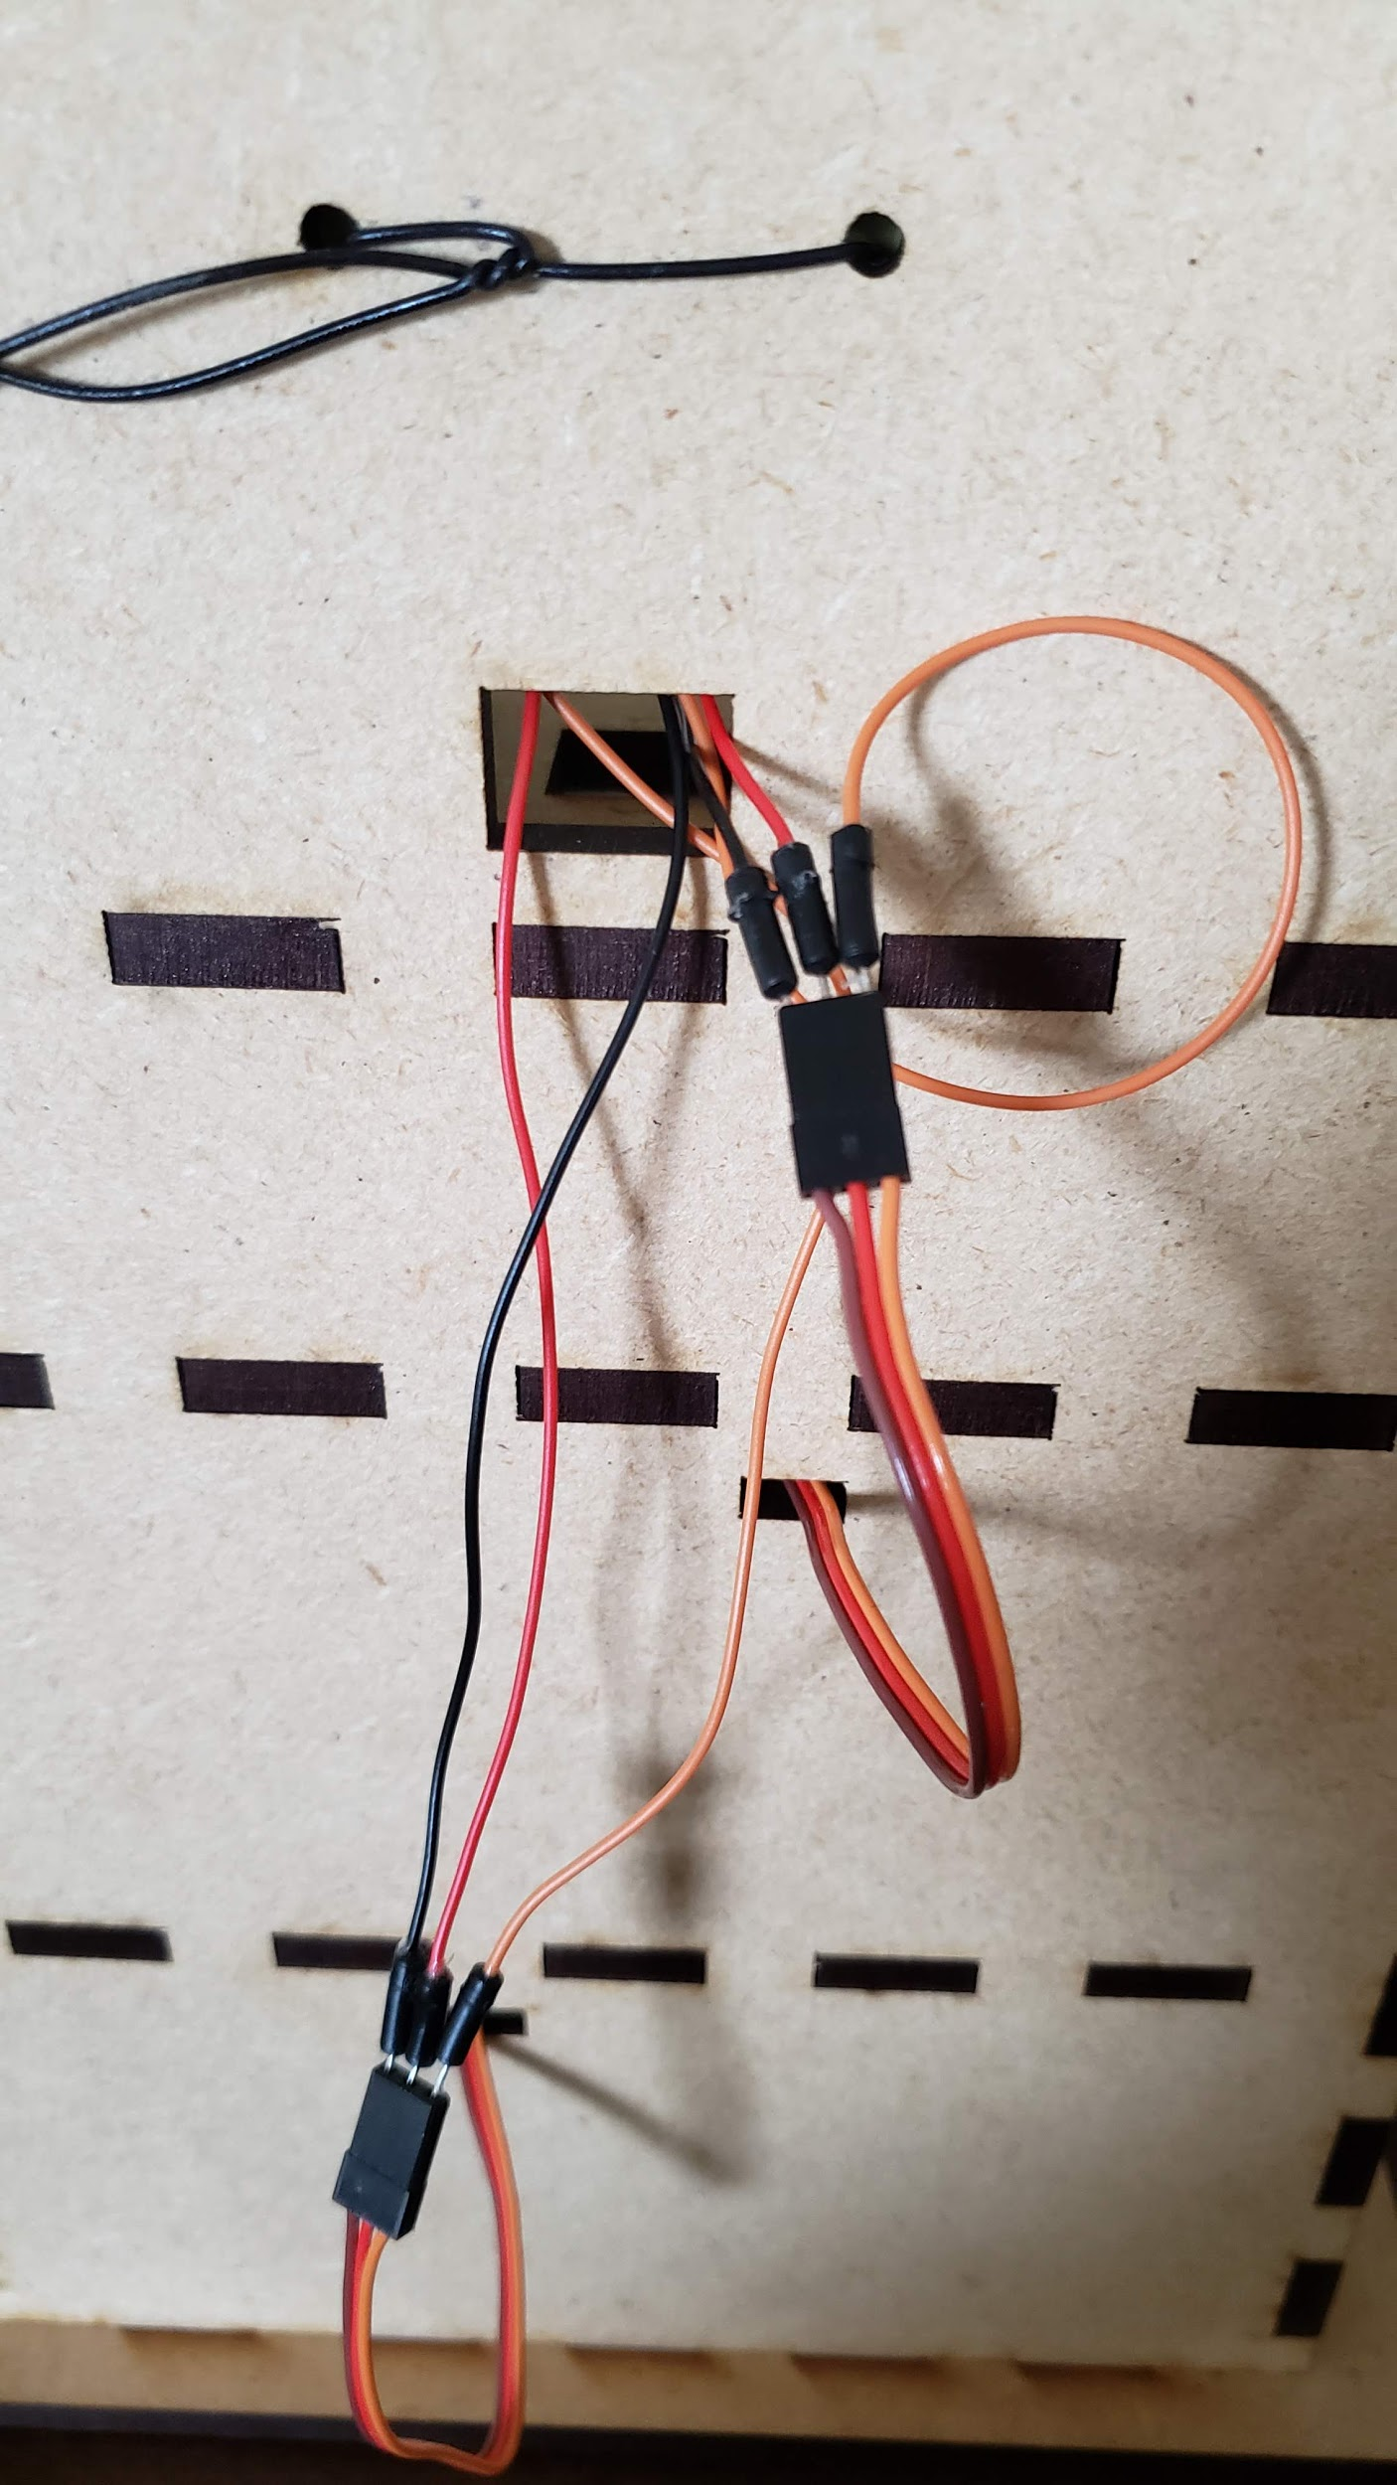
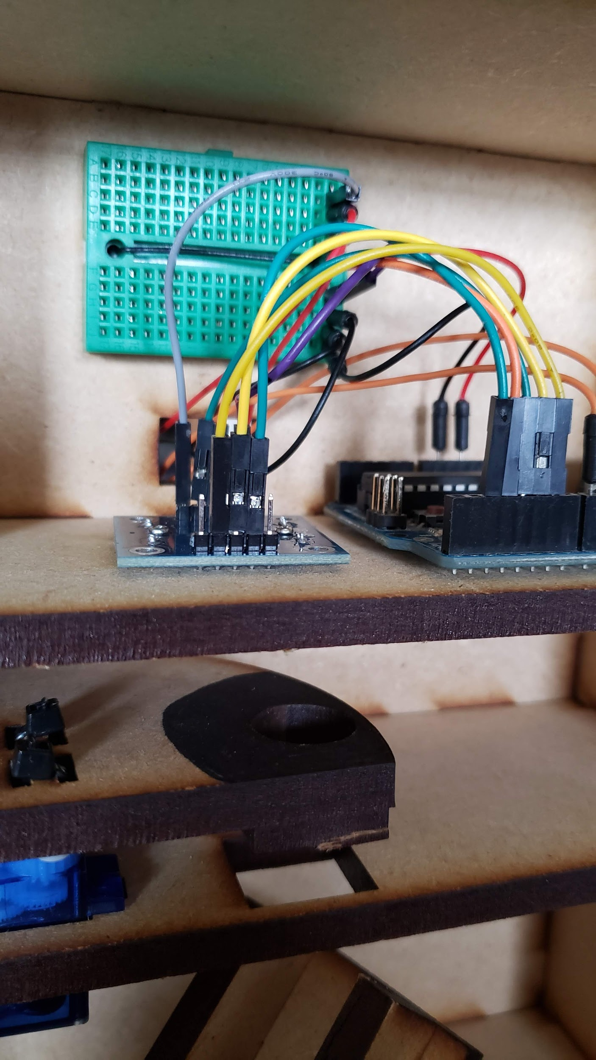
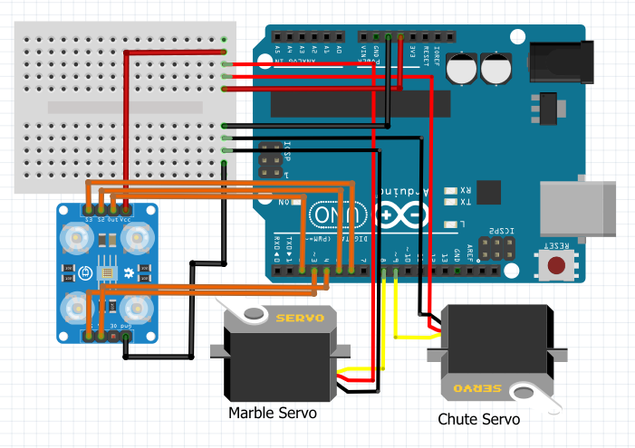
Wiring
Notes:
The circuit diagram was made using fritzing

Slide 18
Section 5:
Coding

Slide 19
Lower Servo
Recall from section #6
Find position (degree value) of each of the dropping “cups”
Using servoObject.write(‘degree value’)
Assign each value to a variable when found
Notes:
The solution code is posted in next slide but hidden from the actual presentation

Slide 20
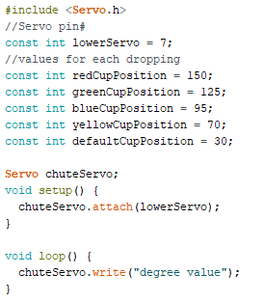
Lower Servo Solution
*Your cup position values might differ
8;

Slide 21
Upper Servo
Recall from section #6
Find position (degree value) of the pick-up, color sensor, and drop
Using servoObject.write(‘degree value’)
Assign each value to a variable when found
Notes:
The solution code is posted in next slide but hidden from the actual presentation

Slide 22
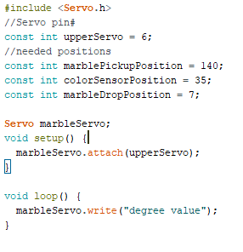
Upper Servo Solution
*Your cup position values might differ
7;

Slide 23
Color Sensor - Calibration
Recall from section #6
We need to get the values for different colors
Write a function for checking colors (void checkColor()) that will print the values out (Serial.print())
Record the values (R;G;B) for all the marbles
Notes:
The solution code is posted in next slide but hidden from the actual presentation

Slide 24
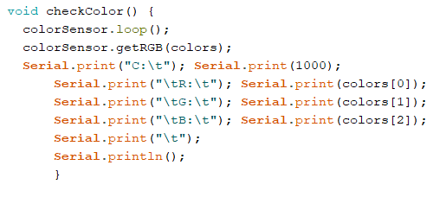
Color Sensor - Calibration Solution
*Don’t forget to have Serial.begin() in order to use Serial.print()

Slide 25
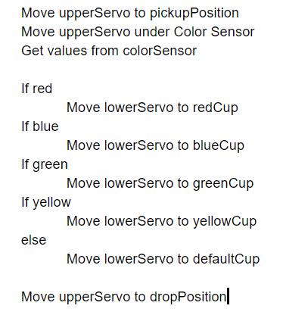
Logic
Pseudo Code
*Add delays when you moving servos
*checkColors has to be inside a loop so it runs many times

Slide 26
Solution
Notes:
Solution is attached inside the unit folder

